Slide 1
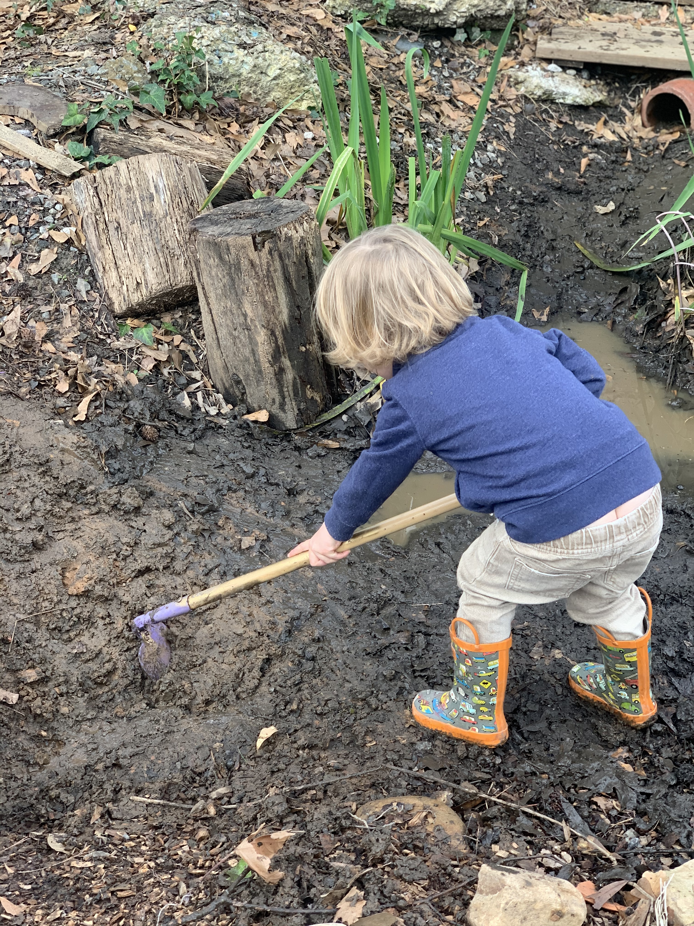
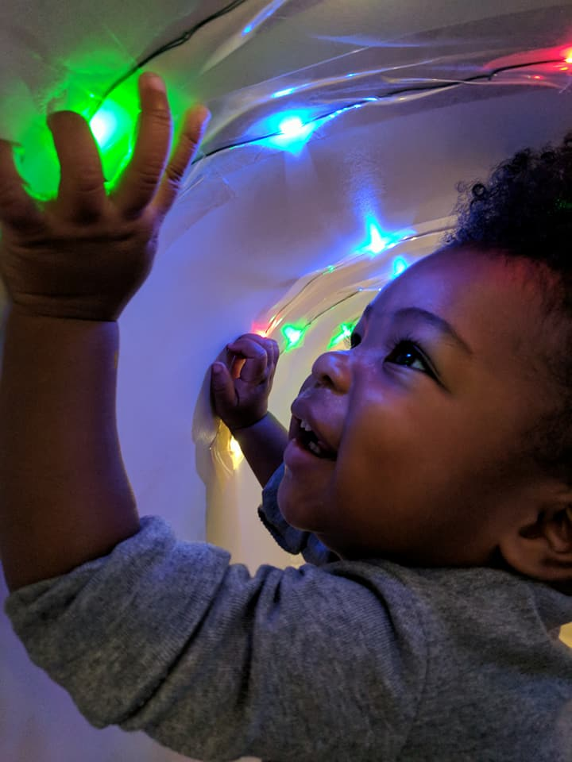
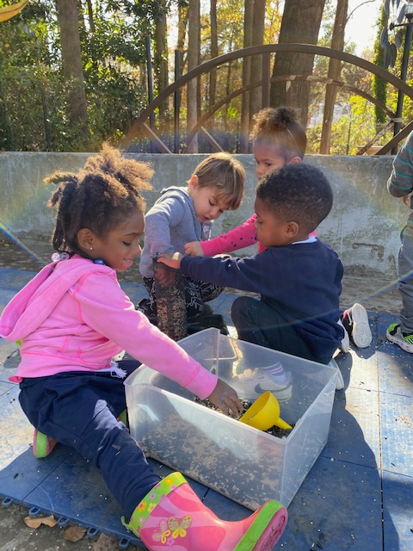
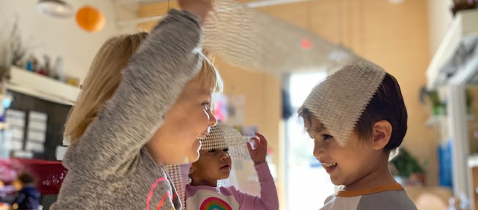
RELATIONSHIPS. Relationships are nurtured in a culture of connection, collaboration, and caring.
EXPERIMENTATION. Through experimentation, we embrace creativity, inquiry and exploration as essential components of learning and teaching.
VALUES
EMPATHY. Empathy emerges in a culture of openness, curiosity, reflection, perspective-taking, and awareness.
JOY. Joy makes living and learning more meaningful and pleasurable.

